Slide 1



Pizza dashboard
View in Power BI
Last data refresh:
16/03/2025 11:32:50 UTC
Downloaded at:
17/03/2025 07:19:45 UTC

Slide 2
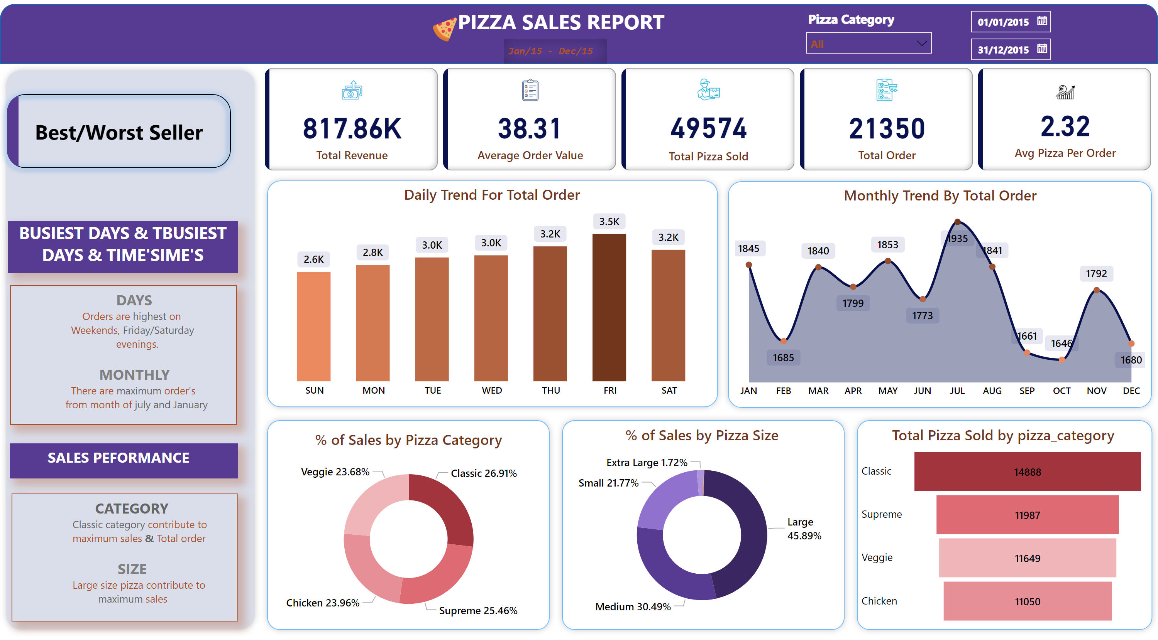
Home
Notes:
cardVisual
No alt text provided
shape
No alt text provided
textbox
No alt text provided
textbox
No alt text provided
image
No alt text provided
shape
No alt text provided
Daily Trend For Total Order
No alt text provided
shape
No alt text provided
Monthly Trend By Total Order
No alt text provided
shape
No alt text provided
shape
No alt text provided
shape
No alt text provided
% of Sales by Pizza Category
No alt text provided
% of Sales by Pizza Size
No alt text provided
funnel
No alt text provided
shape
No alt text provided
textbox
No alt text provided
textbox
No alt text provided
textbox
No alt text provided
textbox
No alt text provided
slicer
No alt text provided
slicer
No alt text provided
pageNavigator
No alt text provided

Slide 3
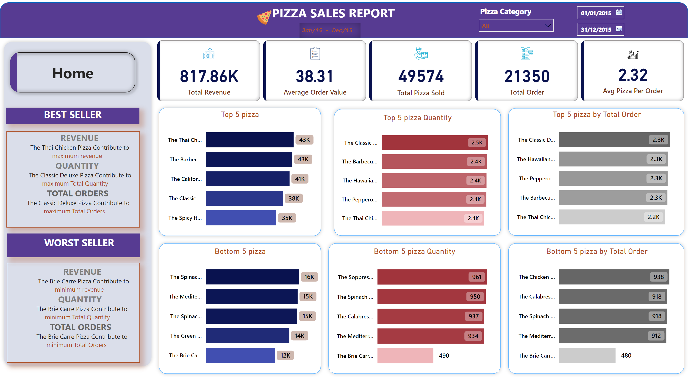
Best/Worst Seller
Notes:
cardVisual
No alt text provided
shape
No alt text provided
textbox
No alt text provided
textbox
No alt text provided
image
No alt text provided
shape
No alt text provided
shape
No alt text provided
textbox
No alt text provided
textbox
No alt text provided
textbox
No alt text provided
textbox
No alt text provided
slicer
No alt text provided
slicer
No alt text provided
shape
No alt text provided
shape
No alt text provided
shape
No alt text provided
shape
No alt text provided
shape
No alt text provided
Top 5 pizza
No alt text provided
Bottom 5 pizza
No alt text provided
Top 5 pizza Quantity
No alt text provided
Bottom 5 pizza Quantity
No alt text provided
Top 5 pizza by Total Order
No alt text provided
Bottom 5 pizza by Total Order
No alt text provided
pageNavigator
No alt text provided

